Slide 1
Week 2: Project Planning, SWE Practices, & DevOps
UML cloud computing club

Slide 2
Announcements
New UniPath.io Project Repository!
Meeting Restructure: Every meeting will be from 6:30pm-9:30pm.
Presentation Section (6:30pm-8:00pm): This portion is reserved for presentations, demos, and sometimes special guest speakers. It is more structured and follows the weekly topics closely.
Hands-On Section (8:00pm-9:30pm): This time is allocated for working on the semester project. It is more interactive, free-flowing, and unplanned, allowing for hands-on experience and collaboration.
We are in the process of getting better rooms
Guest speakers to be announced soon!

Slide 3
Agenda & Objectives
Introduction
Project Planning
Software Engineering Practices
Introduction to DevOps
Hands-On Activity
Understand the fundamentals and importance of Project Planning
Gain insights into Software Engineering Practices
Learn the basics and significance of DevOps

Slide 4
Project Planning
Introduction to Agile methodologies like Scrum and Kanban
Importance of effective project planning in software development
Role of user stories and epics in defining project scope
Brainstorm Project Requirements and create a sample backlog

Slide 5

Project Planning: Introduction to Agile methodologies
https://www.youtube.com/watch?v=8eVXTyIZ1Hs

Slide 6

Project Planning: Introduction to Agile methodologies
https://www.youtube.com/watch?v=Bcid33tgq8A

Slide 7
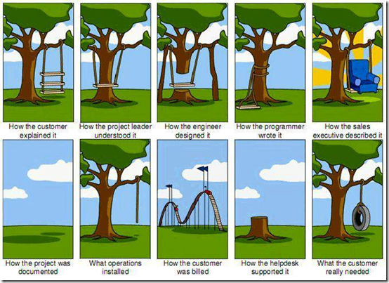
Project Planning: Importance of effective project planning in software development
Risk Mitigation
Early identification of potential issues
Allows for contingency planning
Resource Allocation
Ensures optimal use of time, money, and manpower
Helps avoid bottlenecks and delays
Clear Objectives
Sets measurable goals and KPIs
Provides a roadmap for the team
Stakeholder Alignment
Ensures all stakeholders have a clear understanding of project scope and objectives
Facilitates better communication and expectations management
Quality Assurance
Allows time for adequate testing and quality checks
Reduces the likelihood of costly late-stage changes or rework
Timeline Management
Helps in setting realistic deadlines
Allows for tracking progress and making adjustments as needed
Cost Efficiency
Better planning can lead to cost savings through optimized resource usage
Helps avoid scope creep that can inflate budgets

Slide 8
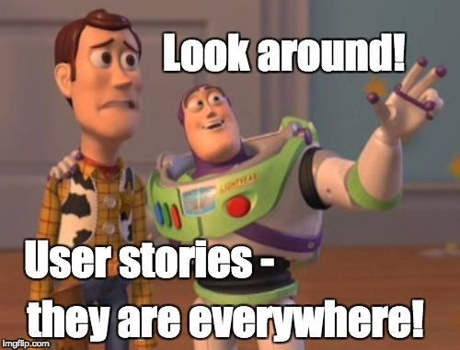
Project Planning: Role of user stories and epics in defining project scope
What are User Stories?
Short, simple descriptions of a feature from the perspective of the user
Format: "As a [user type], I want [an action] so that [benefit/value].“
“As a student, I want to be able to create a long-term degree plan so that I can see what classes I need to take each semester”
What are Epics?
Large bodies of work that can be broken down into smaller tasks or stories
Often span multiple sprints or even releases
Defining Scope
User stories and epics help in outlining the scope of the project
Provide a structured way to capture requirements

Slide 9
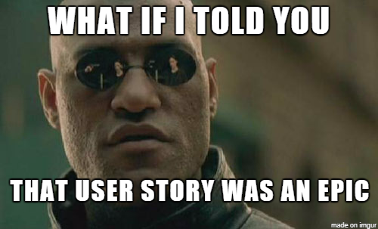
Project Planning: Role of user stories and epics in defining project scope
Prioritization
Helps in ranking what features or tasks are more important or urgent
Allows for better sprint planning
Traceability
Easy to track progress at both micro (user story) and macro (epic) levels
Helps in accountability and performance metrics
Flexibility
User stories can be easily updated or reprioritized
Allows for agile response to changes in project requirements or market conditions

Slide 10
Project Planning: Brainstorm Project Requirements and create a sample backlog
Epic: Degree Planning
As a student, I want to be able to create a long-term degree plan so that I can see what classes I need to take each semester.
As a student, I want to be able to edit my degree plan so that I can make adjustments as needed.
Epic: User Interface
As a user, I want to have a responsive design so that I can use the app on any device.
As a user, I want to be able to easily navigate through the app so that I can find what I'm looking for quickly.
Epic: Schedule Sharing
As a student, I want to be able to share my class schedule with friends so that we can coordinate our classes.
As a student, I want to be able to export my schedule so that I can print it or save it for later.

Slide 11

Project Planning: Questions?
Questions?

Slide 12
Software Engineering Practices
Importance of code quality and readability
Introduction to Git as a version control system
Basic Git commands: clone, add, commit, push, pull
GitHub for collaborative coding: Repositories, Issues, Pull Requests
Discuss coding standards, linting, and code documentation
Role of testing: Unit tests, Integration tests, and End-to-End tests

Slide 13
Software Engineering Practices: Importance of code quality and readability
Why is Code Quality Important?
Reliability: Well-written code is less prone to errors and bugs.
Maintainability: High-quality code is easier to update and maintain.
Scalability: Quality code can be easily expanded for future requirements.
Why is Code Readability Important?
Collaboration: Readable code is easier for team members to understand and work on.
Debugging: Easier to identify issues and implement fixes.
Onboarding: New team members can quickly understand and contribute to the project.
Best Practices for Code Quality
Code Reviews
Unit Testing
Continuous Integration
Best Practices for Code Readability
Proper Naming Conventions
Commenting and Documentation
Consistent Indentation and Formatting

Slide 14
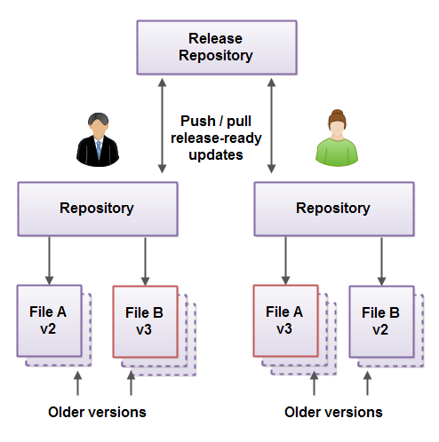
Software Engineering Practices: Introduction to Git as a version control system
What is Git?
A distributed version control system that helps track changes in source code during software development.
Why Use Git?
Collaboration: Allows multiple developers to work on the same project.
Versioning: Keeps a history of all changes, making it easy to revert to previous versions.
Branching: Enables working on different features or bugs simultaneously without affecting the main codebase.

Slide 15
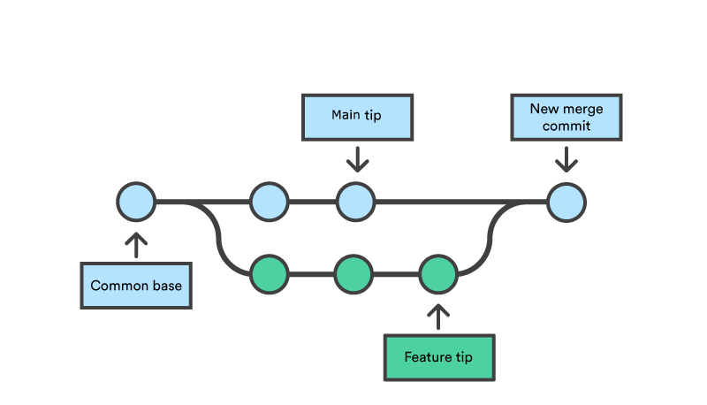
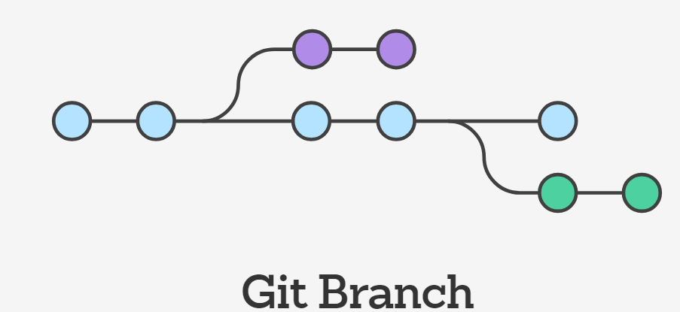
Software Engineering Practices: Introduction to Git as a version control system
Core Concepts in Git
Repository: The container for the source code and its history.
Commit: A snapshot of changes in the code.
Branch: A separate line of development within the same project.
Merge: Combining changes from different branches.
Clone: Creating a local copy of a remote repository.

Slide 16
Software Engineering Practices: GitHub for collaborative coding: Repositories, Issues, Pull Requests
What is GitHub?
A web-based platform that uses Git for version control, enabling multiple people to collaborate on projects.
Key Features:
Repositories
Online storage space for your project.
Can be public or private.
Includes code, documentation, and other project files.
Issues
Used for tracking bugs, enhancements, tasks, and other project-related concerns.
Anyone can create an issue, and project collaborators can comment and assign tasks.
Pull Requests
The process of submitting changes for review.
Allows for code review and discussion before merging.
Can be linked to issues to track the completion of tasks.

Slide 17

Software Engineering Practices: GitHub for collaborative coding: Repositories, Issues, Pull Requests
https://www.youtube.com/watch?v=d3N2yeAaLkc

Slide 18
Software Engineering Practices: Discuss coding standards, linting, and code documentation
Coding Standards
Set of guidelines for writing code.
Ensures consistency and readability across the project.
Linting
Automated code analysis tool.
Helps to enforce coding standards and catch errors early.
Code Documentation
Comments and documentation within the code.
Makes it easier to understand the code's purpose and functionality.
Why It Matters
Ensures code quality and maintainability.
Facilitates collaboration by making code easier to read and understand.

Slide 19
Software Engineering Practices: Role of testing: Unit tests, Integration tests, and End-to-End tests
Unit Tests
Test individual components or functions.
Quick to run, easy to debug.
Integration Tests
Test the interaction between multiple components.
Validates that different parts of the system work together.
End-to-End Tests
Test the system as a whole, often using automated UI tests.
Validates the entire process from start to finish.
Why It Matters
Ensures reliability and robustness of the software.
Catches issues early, reducing the cost of fixing bugs.

Slide 20
Software Engineering Practices: Questions?
Questions?

Slide 21
Introduction to DevOps
Definition and significance of DevOps in modern software development
Importance of Continuous Integration (CI) and Continuous Deployment (CD)
How Git and GitHub Actions fit into CI/CD pipelines
Brief overview of DevOps tools like Jenkins, Docker, and Kubernetes
Discuss the DevOps lifecycle: Plan, Code, Build, Test, Release, Deploy, Operate, Monitor

Slide 22
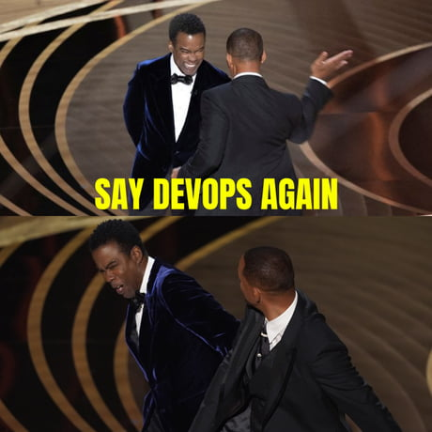
Introduction to DevOps: Definition and significance of DevOps in modern software development
What is DevOps?
DevOps is a set of practices that combines software development (Dev) and IT operations (Ops).
Aims to shorten the system development life cycle and provide continuous delivery.
Significance in Modern Software Development
Accelerates the development process.
Enhances collaboration between development and operations teams.
Improves efficiency through automation.
Increases the reliability and quality of the software.
Key Components
Continuous Integration (CI)
Continuous Deployment (CD)
Infrastructure as Code (IaC)
Why It Matters
Enables rapid innovation and faster time-to-market.
Reduces the cost and risk of software changes.

Slide 23
Introduction to DevOps: Importance of Continuous Integration (CI) and Continuous Deployment (CD)
What is Continuous Integration (CI)?
CI is the practice of automatically integrating code changes from multiple contributors into a single software project.
Involves automated testing to detect errors early.
What is Continuous Deployment (CD)?
CD is the automated process of deploying software changes to a staging or production environment.
Ensures that you can release new changes to your customers quickly in a sustainable way.
Why Are CI/CD Important?
Speed: Accelerate release cycles, enabling faster innovation.
Quality: Automated tests improve software quality, reducing the cost of defects.
Reliability: Consistent, automated deployment process improves reliability.
Collaboration: Encourages better collaboration between developers, testers, and operations.

Slide 24
Introduction to DevOps: How Git and GitHub Actions fit into CI/CD pipelines
Git
What is it?: A distributed version control system.
Role in CI/CD: Source code management, versioning, and branching.
Why Use Git?: Enables collaboration and serves as the starting point for CI/CD pipelines.
GitHub Actions
What is it?: A CI/CD service by GitHub.
Role in CI/CD: Automates workflows, including build, test, and deploy tasks.
Why Use GitHub Actions?: Seamlessly integrates with GitHub repositories, customizable with YAML files.
Integration Points
Source Code: Git repositories serve as the source of truth.
Automation: GitHub Actions reads from the Git repository to execute CI/CD tasks.
Feedback Loop: Both can notify developers of build statuses, errors, or successful deployments.

Slide 25
Introduction to DevOps: Brief overview of DevOps tools like Jenkins, Docker, and Kubernetes
Jenkins
What is it?: An open-source automation server.
Key Features: Build automation, testing, and deployment.
Why Use Jenkins?: Streamlines the CI/CD pipeline, integrates with a multitude of technologies.
Docker
What is it?: A platform for containerization.
Key Features: Package, distribute, and manage applications within containers.
Why Use Docker?: Ensures consistency across multiple development and release cycles.
Kubernetes
What is it?: An open-source container orchestration platform.
Key Features: Automates deployment, scaling, and management of containerized applications.
Why Use Kubernetes?: Manages and scales complex applications with ease.

Slide 26
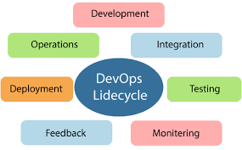
Introduction to DevOps: Discuss the DevOps lifecycle: Plan, Code, Build, Test, Release, Deploy, Operate, Monitor
The DevOps Lifecycle
Plan: Define objectives, requirements, and KPIs.
Code: Develop the application, write scripts, and store in version control.
Build: Compile, assemble, and package the code.
Test: Validate functionality, performance, and security.
Release: Prepare the code for deployment, versioning, and rollback plans.
Deploy: Move the code to production or other environments.
Operate: Manage and scale the application.
Monitor: Track performance, errors, and user activity.
Why It Matters
Ensures a seamless transition between Dev and Ops.
Facilitates continuous improvement and rapid delivery.
Enhances collaboration and communication across teams.

Slide 27
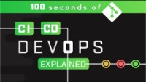
Introduction to DevOps
https://www.youtube.com/watch?v=scEDHsr3APg

Slide 28
Introduction to DevOps: Questions?
Questions?

